Slide 1
CSS342 Data Structures, Algorithms, and Discrete Mathematics (I)

Slide 2
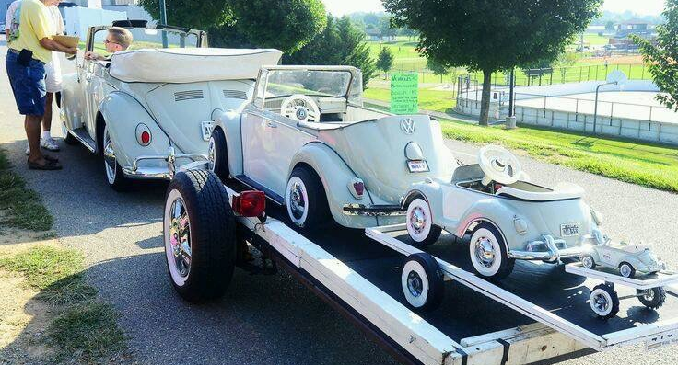
Recursion

Slide 3

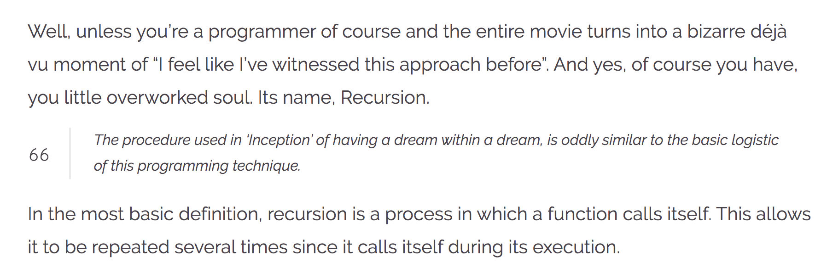
Recursion
https://wewrite.taleas.io/2018/11/14/why-inception-reminds-us-of-recursion/

Slide 4
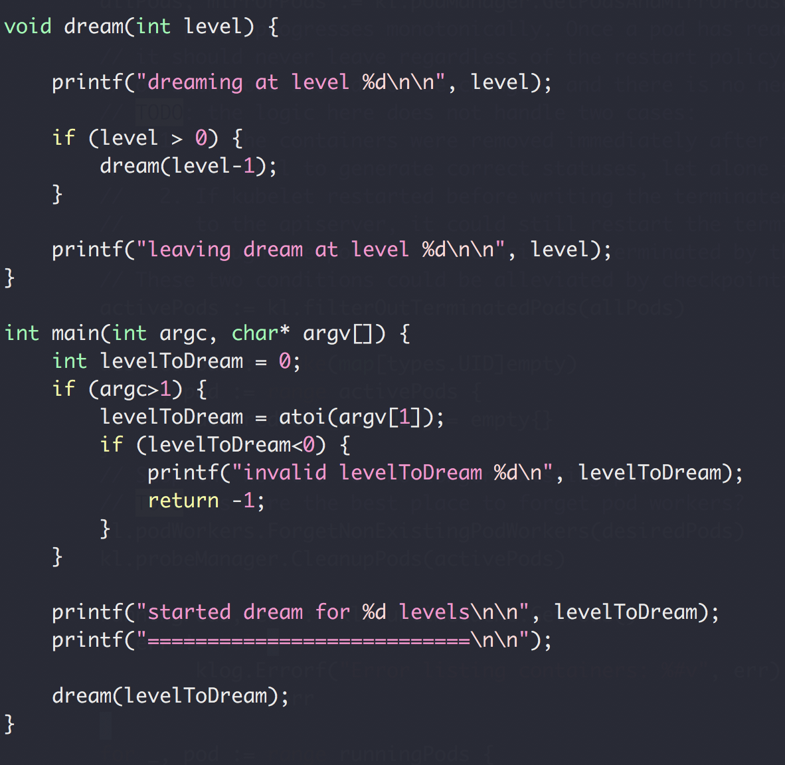
Dream in Recursion

Slide 5
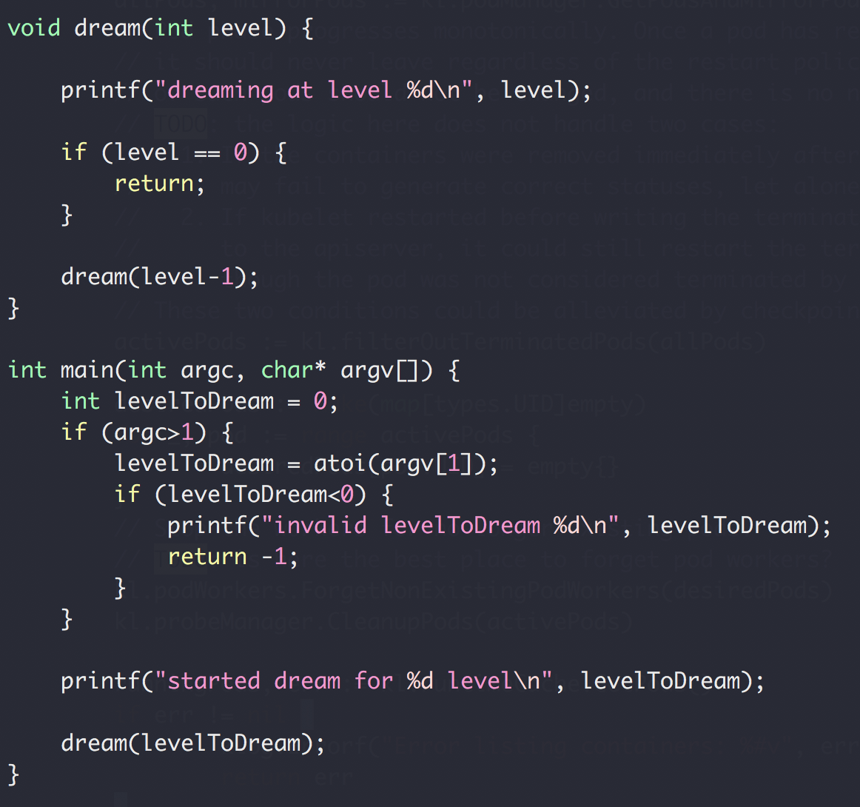
Recursion (and backtracking)
Recursion
Split a problem in a smaller subproblem of the same kind
Call self for each subproblem
Stop the recursion when the subproblem is ”small enough” and can be solved directly

Slide 6
Function Call Stack
Heap
Foo() {
// stack
int array1[10];
// heap
int * array2 = new int[20];
delete array2;
}
Foo() {
int array1[10];
int * array2 = new int[20];
delete array2;
}
Stack
Memory

Slide 7
Function Call Stack
Heap
Dream(1)
dream(0)
Dream(0)
Return address of dream(1)
Stack
dream(1)
Return address of main()
main()
Memory
Stack buffer overflow attack

Slide 8
Function Call Stack
Heap
dream(N-4)
Return address of dream(N-3)
dream(N-3)
Return address of dream(N-2)
dream(N-2)
Return address of dream(N-1)
Stack
dream(N-1)
Return address of main()
main()
Memory

Slide 9
Recursion (and backtracking)
Recursion
Split a problem in a smaller subproblem of the same kind
Call self for each subproblem
Stop the recursion when the subproblem is ”small enough” and can be solved directly

Slide 10
Recursion (and backtracking)
Recursion
Split a problem in a smaller subproblem of the same kind
Call self for each subproblem
Stop the recursion when the subproblem is ”small enough” and can be solved directly

Slide 11
Homework Issues
DO NOT SUBMIT .o and .x files
Problem 1, need to verify capacity
If else
2D matrix array memory leak
Do not remove existing code. Only add.
Class file name should match the class
Include cpp file (problem 2)
Matrix constructor no static initialization
Need to verify deep copy (cannot just loop and check value)

Slide 12
Recursion (and backtracking)
How to find the largest apple
In box 0 to 5
0
1
2
3
4
5
Largest apple:
1
1
0

Slide 13
Recursion (and backtracking)
How to find the largest apple
In box 0 to 5 (noted as [0,5])
Get the first apple from [0,5]
Find the largest apple from [1,5]
compare it with apple 0
0
1
2
3
4
5

Slide 14
Recursion (and backtracking)
How to find the largest apple
In box 1 to 5
Get the first apple from [1,5]
Find the largest apple from 2-5
compare it with apple 1
0
1
2
3
4
5

Slide 15
Recursion (and backtracking)
How to find the largest apple
In box 2 to 5
Get the first apple from [2,5]
Find the largest apple from 3-5
compare it with apple 2
0
1
2
3
4
5

Slide 16
Recursion (and backtracking)
How to find the largest apple
In box 1 to 5
Get the first apple from [3,5]
Find the largest apple from 3-5
compare it with apple 3
0
1
2
3
4
5

Slide 17
Recursion (and backtracking)
How to find the largest apple
In box 1 to 5
Get the first apple from [4,5]
Find the largest apple from 4-5
compare it with apple 4
0
1
2
3
4
5

Slide 18
Recursion (and backtracking)
How to find the largest apple
In box 1 to 5
Only 1 apple is left, it’s the largest comparing to itself
0
1
2
3
4
5

Slide 19
Recursion (and backtracking)
How to find the largest apple
In box 1 to 5
Get the first apple from [4,5]
Find the largest apple from 4-5
compare it with apple 4
0
1
2
3
4
5

Slide 20
Recursion (and backtracking)
How to find the largest apple
In box 1 to 5
Get the first apple from [4,5]
Find the largest apple from 4-5
compare it with apple 4
0
1
2
3
4
5

Slide 21
Recursion (and backtracking)
How to find the largest apple
In box 1 to 5
Get the first apple from [3,5]
Find the largest apple from 3-5
compare it with apple 3
0
1
2
3
4
5

Slide 22
Recursion (and backtracking)
How to find the largest apple
In box 1 to 5
Get the first apple from [3,5]
Find the largest apple from 3-5
compare it with apple 3
0
1
2
3
4
5

Slide 23
Recursion (and backtracking)
How to find the largest apple
In box 2 to 5
Get the first apple from [2,5]
Find the largest apple from 3-5
compare it with apple 2
0
1
2
3
4
5

Slide 24
Recursion (and backtracking)
How to find the largest apple
In box 1 to 5
Get the first apple from [1,5]
Find the largest apple from 2-5
compare it with apple 1
0
1
2
3
4
5

Slide 25
Recursion (and backtracking)
How to find the largest apple
In box 1 to 5
Get the first apple from [1,5]
Find the largest apple from 2-5
compare it with apple 1
0
1
2
3
4
5

Slide 26
Recursion (and backtracking)
How to find the largest apple
In box 1 to 5
Get the first apple from [1,5]
Find the largest apple from 2-5
compare it with apple 1
0
1
2
3
4
5

Slide 27
Recursion (and backtracking)
How to find the largest apple
In box 0 to 5 (noted as [0,5])
Get the first apple from [0,5]
Find the largest apple from [1,5]
compare it with apple 0
0
1
2
3
4
5

Slide 28
Recursion (and backtracking)
How to find the largest apple
In box 0 to 5 (noted as [0,5])
Get the first apple from [0,5]
Find the largest apple from [1,5]
compare it with apple 0
0
1
2
3
4
5

Slide 29
A similar question
Find the largest number in an array
Array not sorted
interger
0
1
2
3
4
5

Slide 30
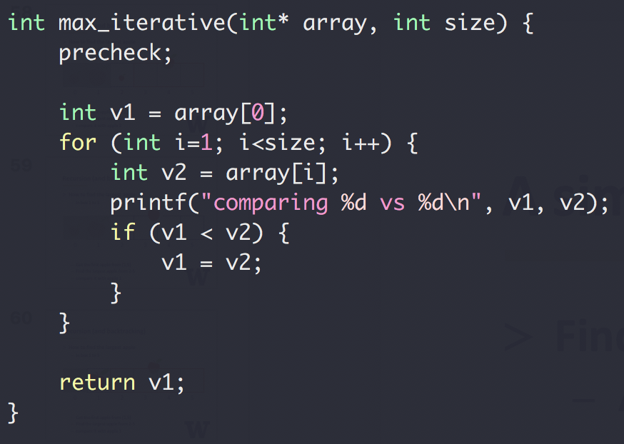
A similar question
Find the largest number in an array
Array not sorted
Integer
Method 1
Iterative

Slide 31
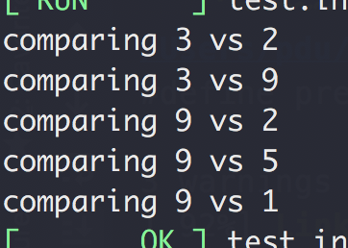
A similar question
Find the largest number in an array
Array not sorted
Integer
Method 1
Iterative
Input: [3,2,9,2,5,1]

Slide 32
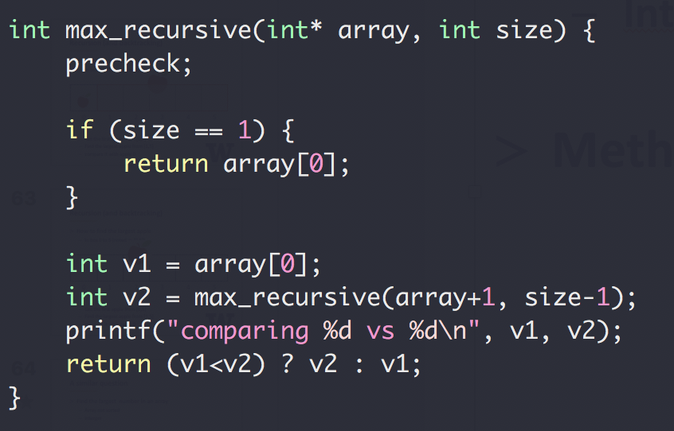
A similar question
Find the largest number in an array
Array not sorted
Integer
Method 2
Recursive

Slide 33
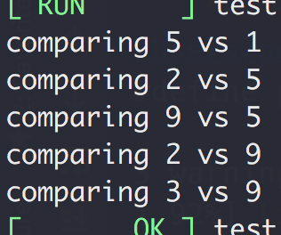
A similar question
Find the largest number in an array
Array not sorted
Integer
Method 1
Recursive
Input: [3,2,9,2,5,1]

Slide 34
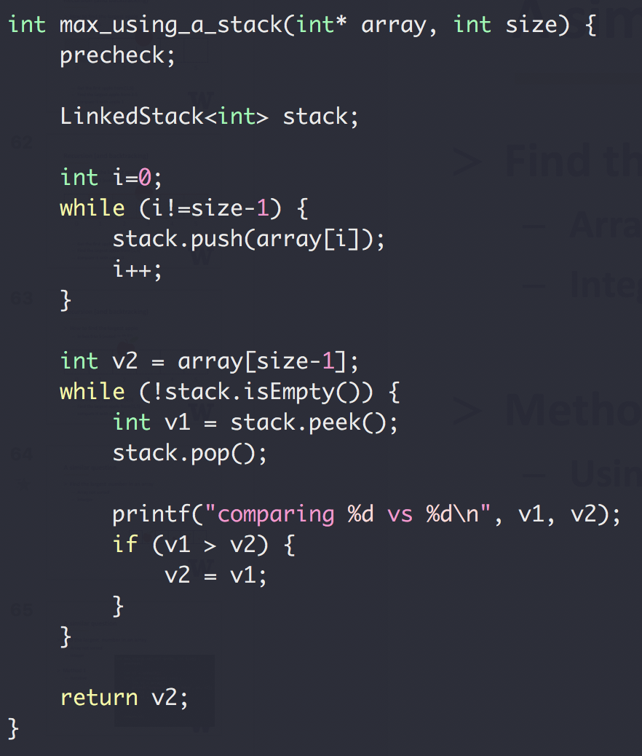
A similar question
Find the largest number in
an array
Array not sorted
Integer
Method 3
Using a stack

Slide 35
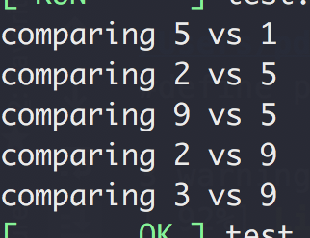
A similar question
Find the largest number in
an array
Array not sorted
Integer
Method 3
Using a stack
Input: [3,2,9,2,5,1]

Slide 36
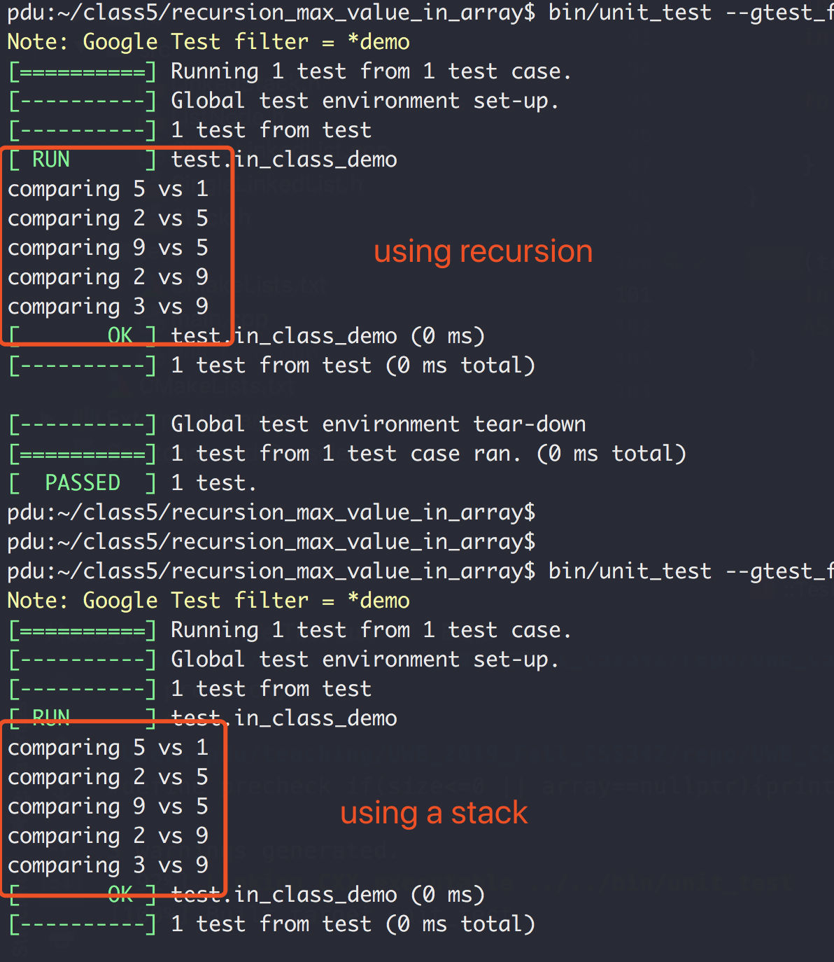
Recursion vs Stack

Slide 37
Recursion

Slide 44
Happy Halloween!

Slide 45

Source Code Version Control
Source control / Version control
Without source control
Code version 1
Code version 2
Code version 3
Code
……
Messed up
Monday
Tuesday
Wednesday
Thursday

Slide 46
Source Code Version Control
Source control / Version control
With source control
Code version 1
Code version 2
Code version 3
Code
……
Messed up
Monday
Tuesday
Wednesday
Thursday

Slide 47
Source Code Version Control
Code version 1
Code version 2
Code version 3
Source control / Version control
With source control
Code version 1
Code version 2
Code version 3
Code
……
Monday
Tuesday
Wednesday
Thursday

Slide 48
Source/Version Control with Git and github.com
Git (tools on local machine to manage source code versions)
Cross-platform (Linux, Windows, Mac, etc)
www.github.com
Code version 1
Code version 2
Code version 3

Slide 49
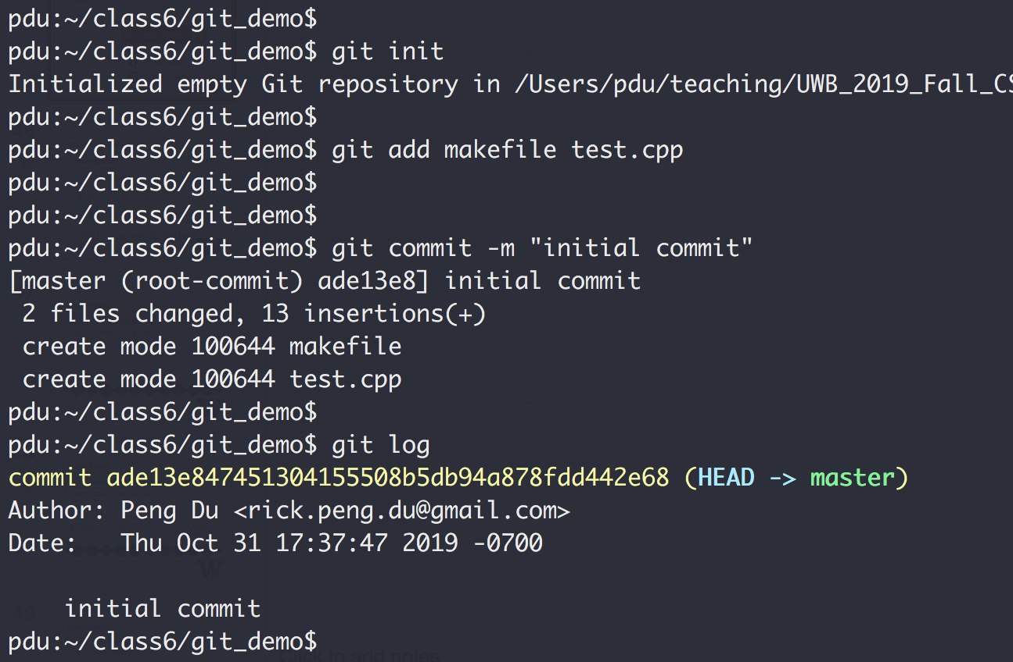
Git Demo
Tutorial: https://www.youtube.com/watch?v=SWYqp7iY_Tc

Slide 50
Recap: Problem Solving with Recursion
Split problem into sub-problem of the same kind
Make recursive call with different
Problem size and/or
Problem location
Stopping condition
Stop the recursion when problem can be solved without further recursion
Recursion vs Stack

Slide 51
Recursion Example
Search Algorithm, random array
Linear Search (target 12)
5 3 1 9 8 7 12 2 4
5 3 1 8 7 9 2 4 12
O(N) Can we do better?
Worse case we have to iterate N element

Slide 52
Binary Search
“Who checked that bug in?!!”
Source control svn, git, etc
1
2
3
4
5
6
7
8
9
10
Mike
Peng
Ethan

Slide 53

Binary Search
“Who checked that bug in?!!”
Source control svn, git, etc
Found a bug in version 10
No bug in version 1
?
?
?
?
?
?
?
?
1
2
3
4
5
6
7
8
9
10

Slide 54
Binary Search
Source control svn, git, etc
“Who checked that bug in?!!”
Found a bug in version 10
No bug in version 1
?
?
?
?
?
?
?
?
1
2
3
4
5
6
7
8
9
10

Slide 55
Binary Search
Source control svn, git, etc
“Who checked that bug in?!!”
Found a bug in version 10
No bug in version 1
?
?
?
?
?
?
?
?
1
2
3
4
5
6
7
8
9
10

Slide 56
Binary Search
Source control svn, git, etc
“Who checked that bug in?!!”
Found a bug in version 10
No bug in version 1
?
?
?
?
?
1
2
3
4
5
6
7
8
9
10
Bug introduced, found with 3 checks

Slide 57
Binary Search
Binary Search, Sorted array
1 2 3 4 5 7 8 9 12
1 2 3 4 5 7 8 9 12
1 2 3 4 5 7 8 9 12
1 2 3 4 5 7 8 9 12
1 2 3 4 5 7 8 9 12
O(logN) both average and worst case

Slide 58
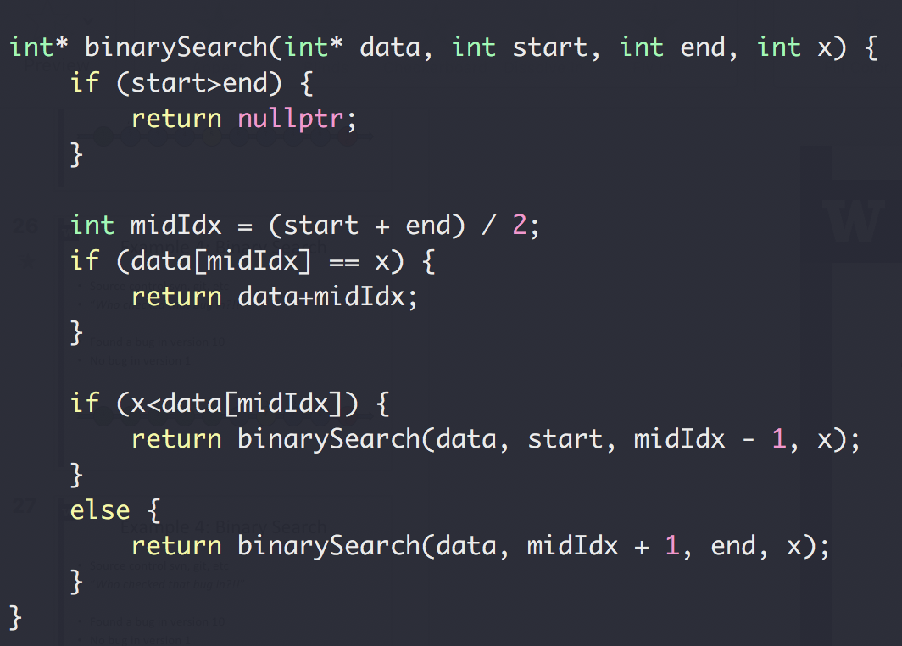
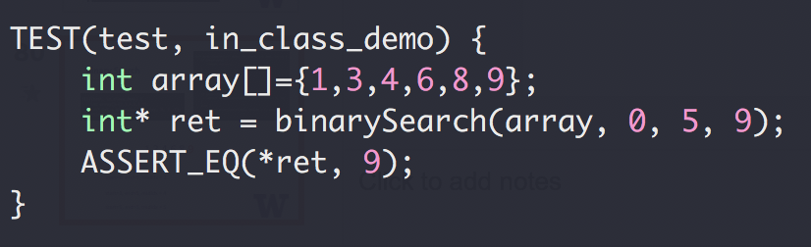
Binary Search

Slide 59
Binary Search
1,3,4,6,8,9
start=0, end=5, midIdx = 2
start=3, end=5, midIdx = 4
start=5, end=5, midIdx = 5

Slide 60
Binary Search
1,3,4,6,8,9
start=0, end=5, midIdx = 2
1,3,4,6,8,9
start=3, end=5, midIdx = 4
1,3,4,6,8,9
start=5, end=5, midIdx = 5

Slide 61
Binary Search
Up to 2³¹-1 for 32-bit signed int
What could go wrong?
The Java programming language library had this bug for 10+ years

Slide 62
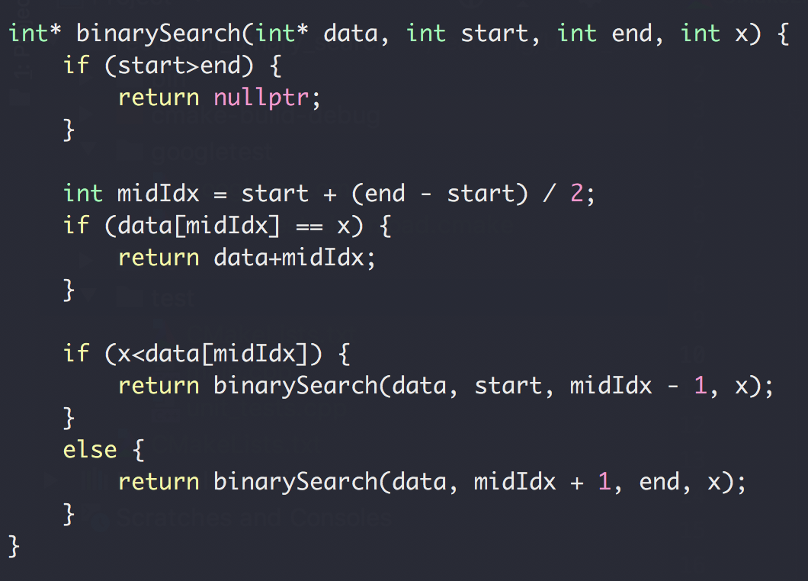
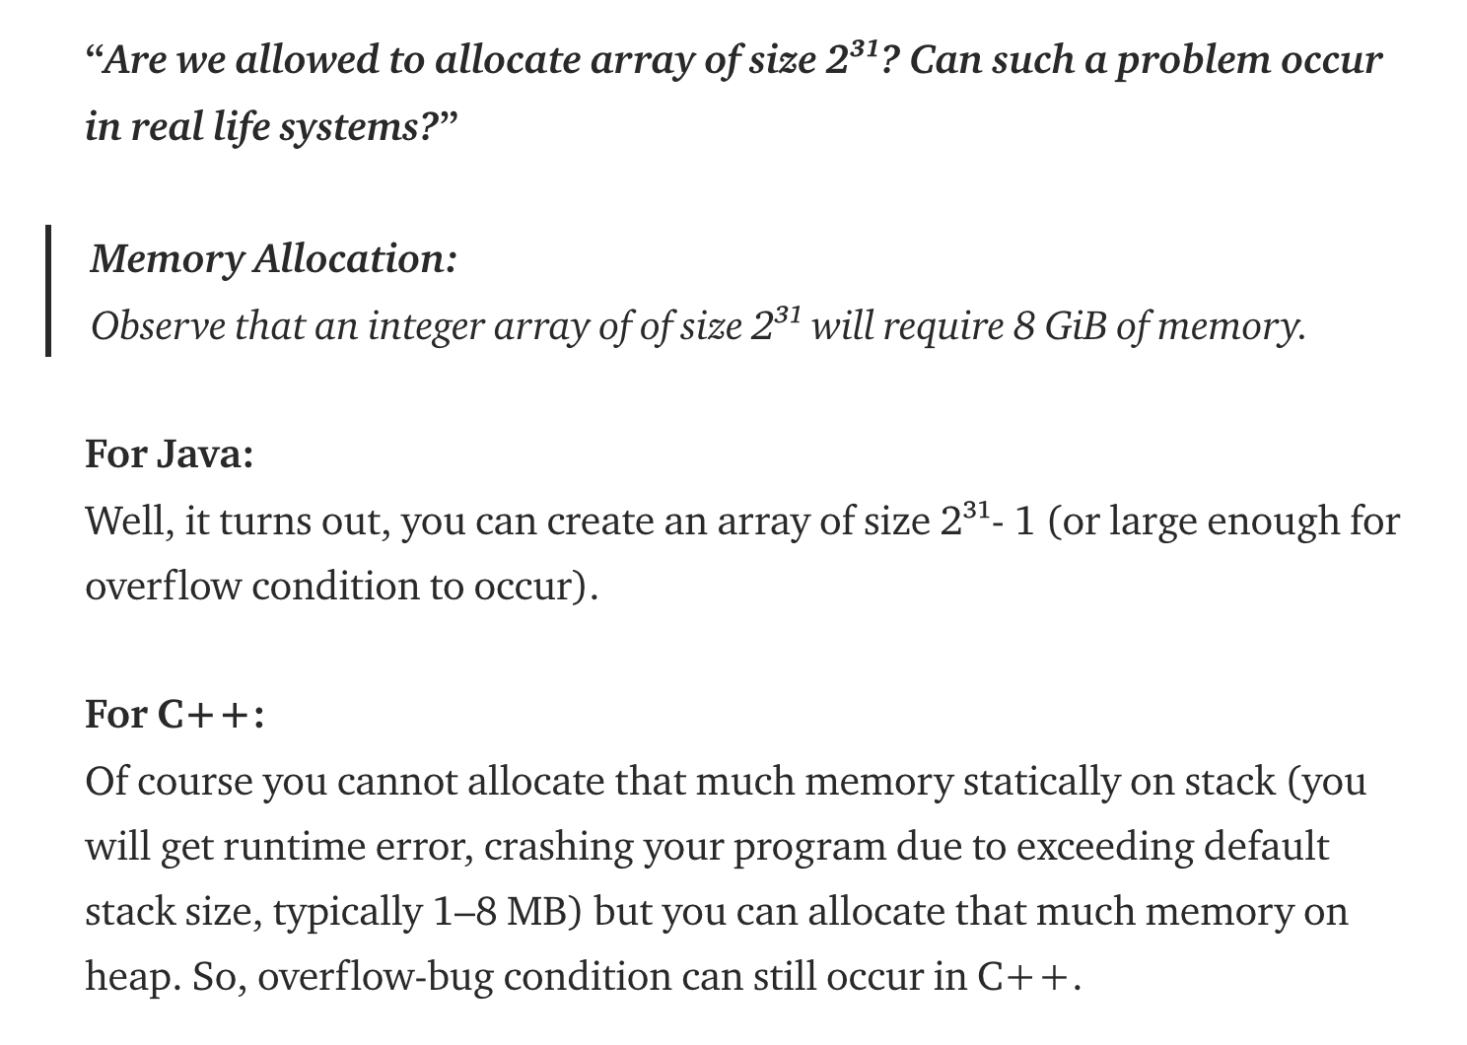
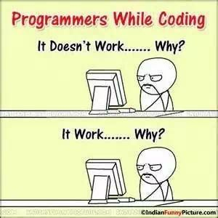
Binary Search
See this about stack memory limitation

Slide 63
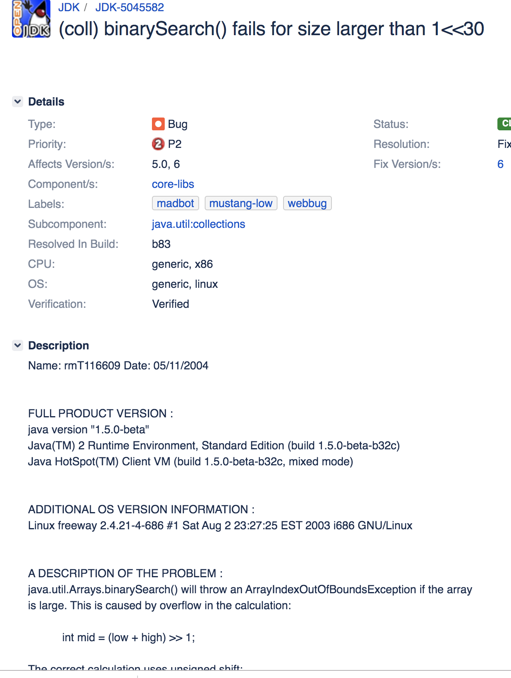
Binary Search
https://bugs.openjdk.java.net/browse/JDK-5045582

Slide 64
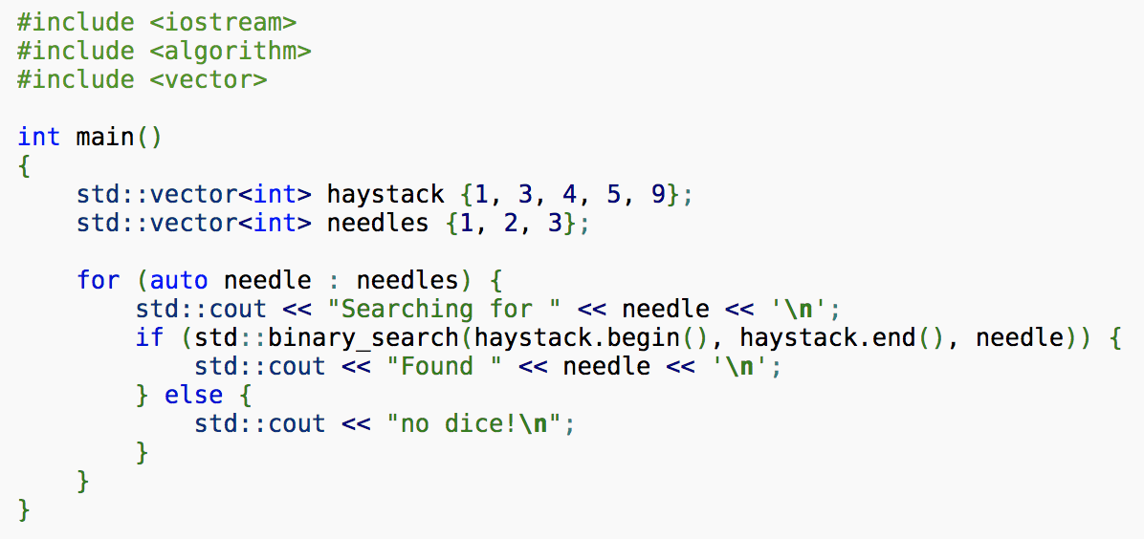
Binary Search
STL implementation

Slide 65
Binary Search Summary
Recursion
Divide and conquer
Range overflow
More efficient O(lgN) than linear search O(N)

Slide 66

Recursion:
You are climbing a stair case. It takes n steps to reach to the top.
Each time you can either climb 1 or 2 steps.
In how many distinct ways can you climb to the top?

Slide 67
Recursion:
You are climbing a stair case. It takes n steps to reach to the top.
Each time you can either climb 1 or 2 steps.
In how many distinct ways can you climb to the top?

Slide 68
Example 4: Climbing Stairs
You are climbing a stair case. It takes n steps to reach to the top. Each time you can either climb 1 or 2 steps.
In how many distinct ways can you climb to the top?
1
n=1
0→1
F(1) = 1
0
0→1→2
N=2
F(2) = 2
0→2

Slide 69
Example 4: Climbing Stairs
You are climbing a stair case. It takes n steps to reach to the top. Each time you can either climb 1 or 2 steps.
In how many distinct ways can you climb to the top?
0→1→3
3
2
N=3
0→1→2→3
1
0
0→2→3

Slide 70
Example 4: Climbing Stairs
You are climbing a stair case. It takes n steps to reach to the top. Each time you can either climb 1 or 2 steps.
In how many distinct ways can you climb to the top?
0→1→3
F(1)
3
2
N=3
0→1→2→3
1
F(2)
0
0→2→3
F(3) = F(2)+F(1)
F(n) = F(n-1)+F(n-2)

Slide 71
Example 4: Climbing Stairs

Slide 72
Example 4: Climbing Stairs
F(5)
F(4)
F(3)
Overlapping sub problem!
F(3)
F(2)
F(2)
F(1)
F(2)
F(1)
F(1) called 317,811 times when N=30

Slide 73
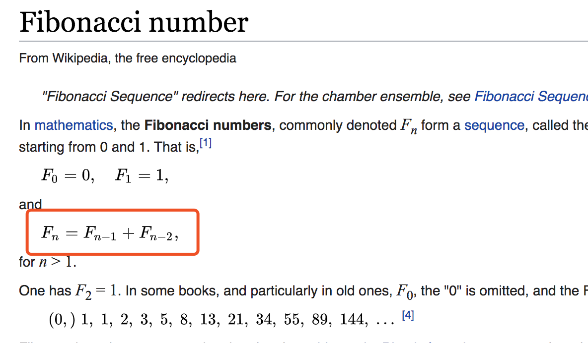
Example 4: Climbing Stairs
F(n) = F(n-1)+F(n-2)
n | 1 | 2 | 3 | 4 | … | 20
F(n) | 1 | 2 | 3 | 5 | … | 10946
Dynamic programming!

Slide 74
Stair Climbing Summary
Recursion
Divide and conquer
Overlapping subproblem (NOT efficient)
Solve with book keeping and bottom up

Slide 75
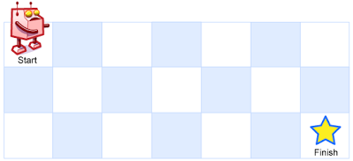
Recursion In Class Exercise
A robot is located at the top-left corner of a m x n grid (marked 'Start' in the diagram below).
The robot can only move either down or right at any point in time. The robot is trying to reach the bottom-right corner of the grid (marked 'Finish' in the diagram below).
How many possible unique paths are there?
https://leetcode.com/problems/unique-paths/

Slide 76
Recursion In Class Exercise
A robot is located at the top-left corner of a m x n grid (marked 'Start' in the diagram below).
The robot can only move either down or right at any point in time. The robot is trying to reach the bottom-right corner of the grid (marked 'Finish' in the diagram below).
How many possible unique paths are there?
1
1
1
1
2
1

Slide 77
Recursion In Class Exercise
1
1
1
1
1
1
2
3
4
5
1
3
6
10
15
Can you solve this without using recursion?

